Slide 1
GPIO

Slide 2
GPIO 제어
GPIO 개요
  GPIO(General Purpose Input Output)는 하나의 연결 단자를 입력이나 출력으로 고정시키지 않고 선택적으로 사용할 수 있게 융통성을 높인 범용 입출력 단자
  Odroid-C에서 외부 IO로 40개의 GPIO 단자를 사용
  각 단자는 입력 혹은 출력으로 설정하거나 부가 기능을 위해 양방향으로 설정.

Slide 3
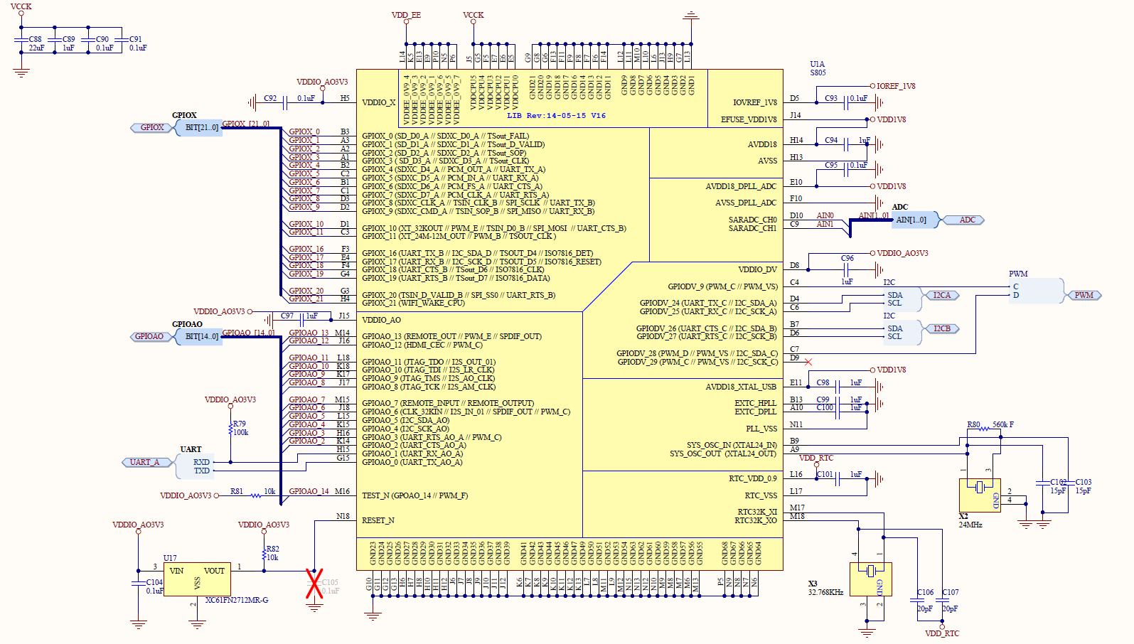
GPIO
Notes:
Gpio의 핀 맵핑을 달라고 해야함.

Slide 4
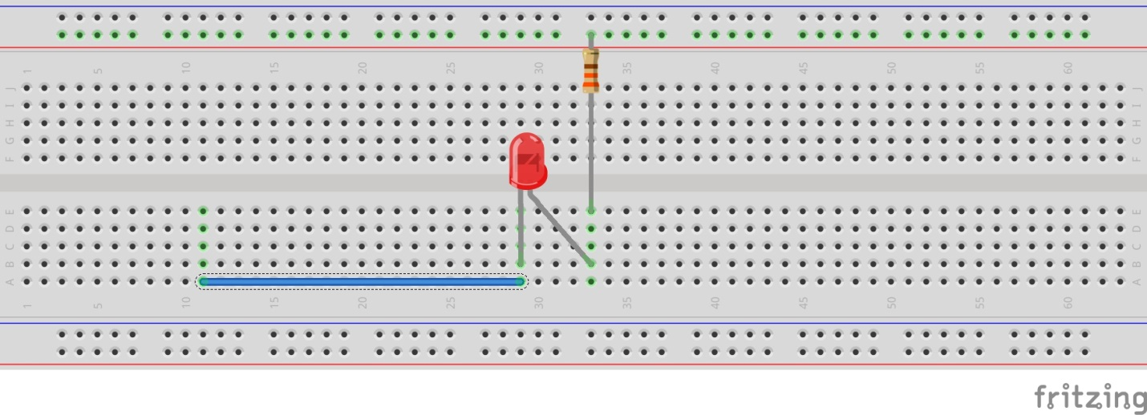

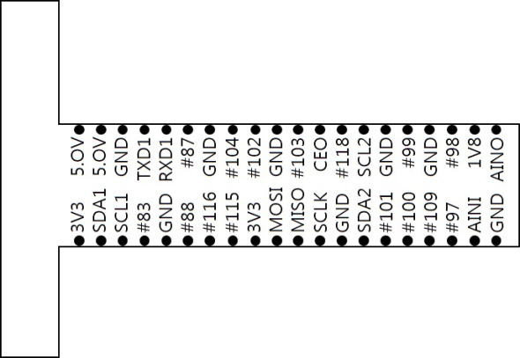
Connect an LED using a resistor between GPIO 97 (#97) and GND
Blinking an LED
330Ω

Slide 5
Introducing the WiringPi library
A GPIO access library written in C
  Writes/reads the base address of the memory allocated to the GPIO
Similar to the Wiring library in the Arduino used to make common IO operations easier
Install the Wiring Pi library following these instructions

Slide 6
WiringPi for Odroid C1
Build & install WiringPi for Odroid C1
Compiling with WiringPi
Host에서
$ cd
$ git clone https://github.com/hardkernel/WiringPi
$ tar –cvf WiringPi.tar WiringPi
Target 보드에서 zmodem으로 복사
$ tar –xvf WiringPi.tar
Error 발생 시:
$ git config –-global http.sslverify false

Slide 7
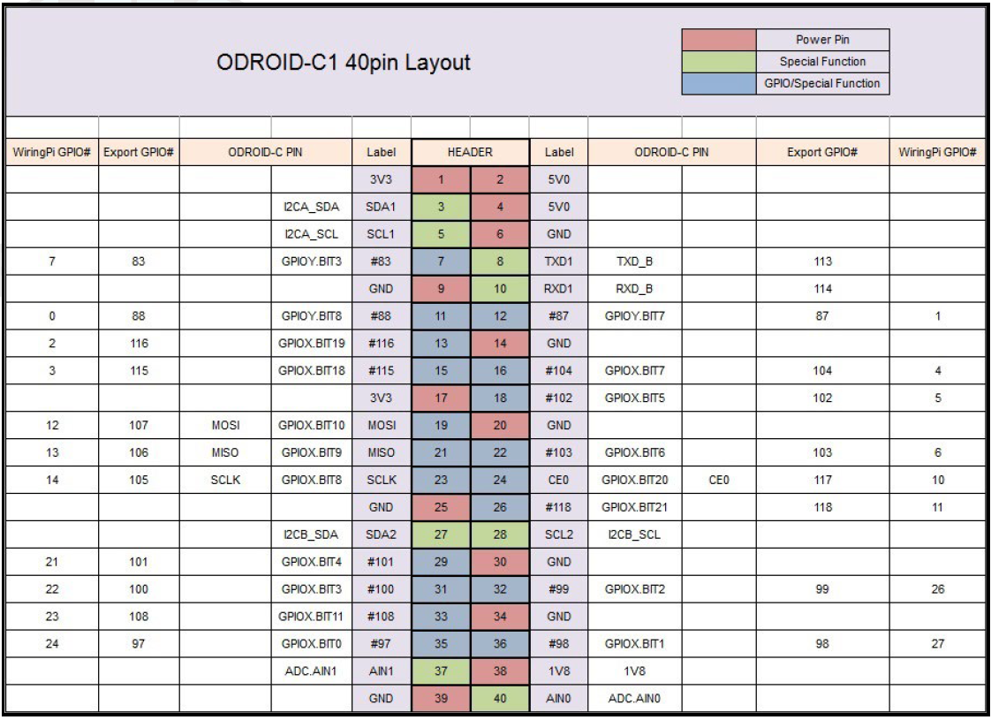
WiringPi for Odroid C1
Notes:
Mosi, miso, sclk , ceo 118 101 100 999

Slide 8
Blinking lights with Wiring
#include <stdio.h>
#include <wiringPi.h>
// LED Pin - wiringPi pin 24 is Odroid-C1 GPIO 97.
#define LED 24
int main (void) {
printf (“Blink!\n") ;
wiringPiSetup () ; // ⬅ note the setup method chosen
pinMode (LED, OUTPUT) ;
for (;;) {
digitalWrite (LED, HIGH) ; // On
delay (500) ; // mS
digitalWrite (LED, LOW) ; // Off
delay (500) ;
}
return 0 ;
}

Slide 9
Running blink
Compile and run the blink program
  $ gcc blink.c -o blink -lwiringPi -lwiringPiDev -lpthread -lcrypt -lm -lrt ⬅ compile
  $ ./blink ⬅ run
Runs forever---kill with the command ctrl-c ctrl-c
Note: One of the four wiring setup functions must be called at the start of your program or your program will not work correctly
  gcc blink2.c -o blink2 -lwiringPi -lwiringPiDev -lpthread -lcrypt -lm -lrt

Slide 10
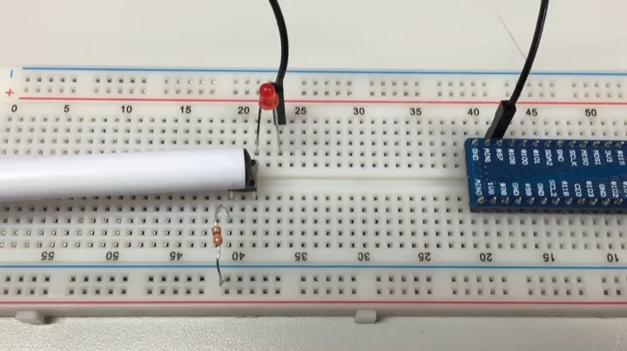
GPIO 실습 1
Use of switch
- switch 사용하여 switch 클릭 시, LED 불 on

Slide 11
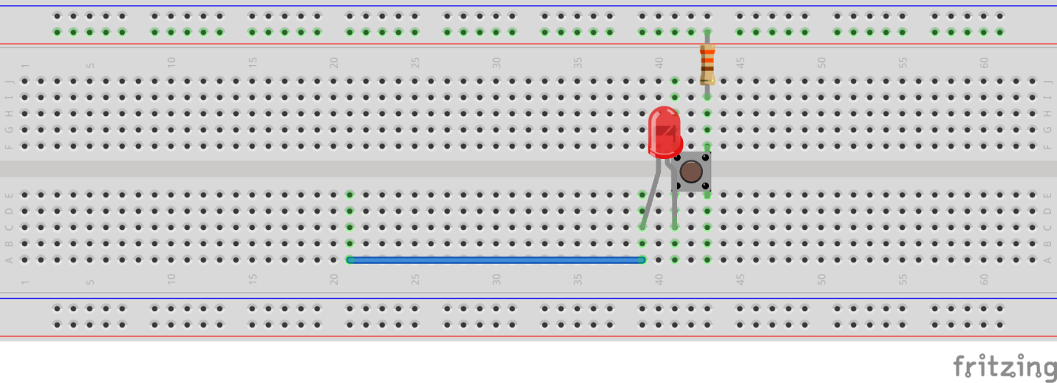
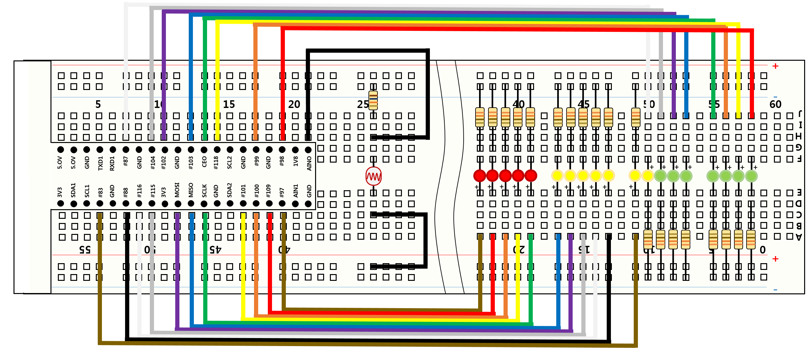
GPIO 실습 2

Slide 12
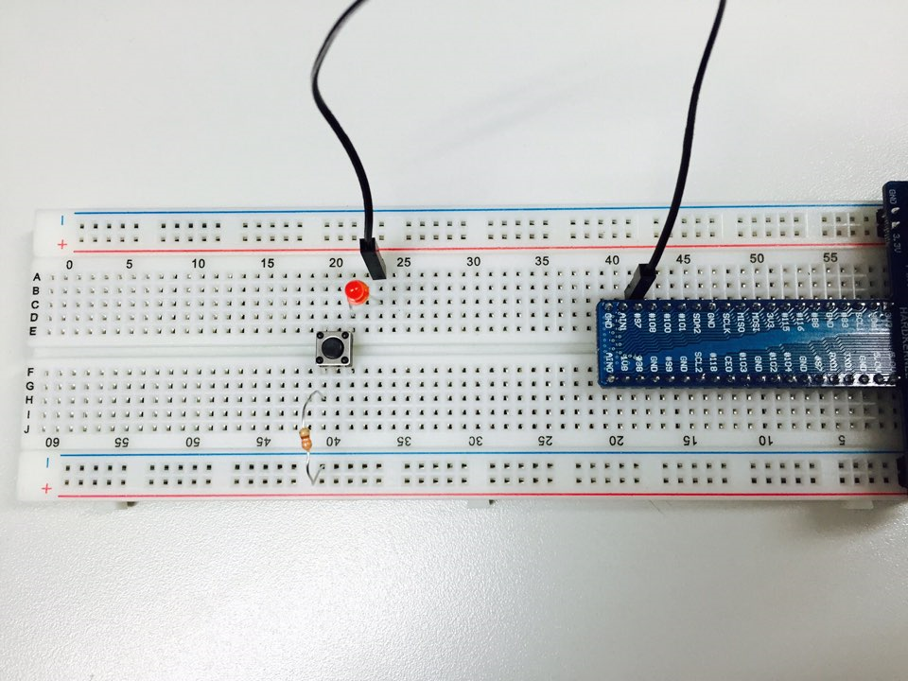
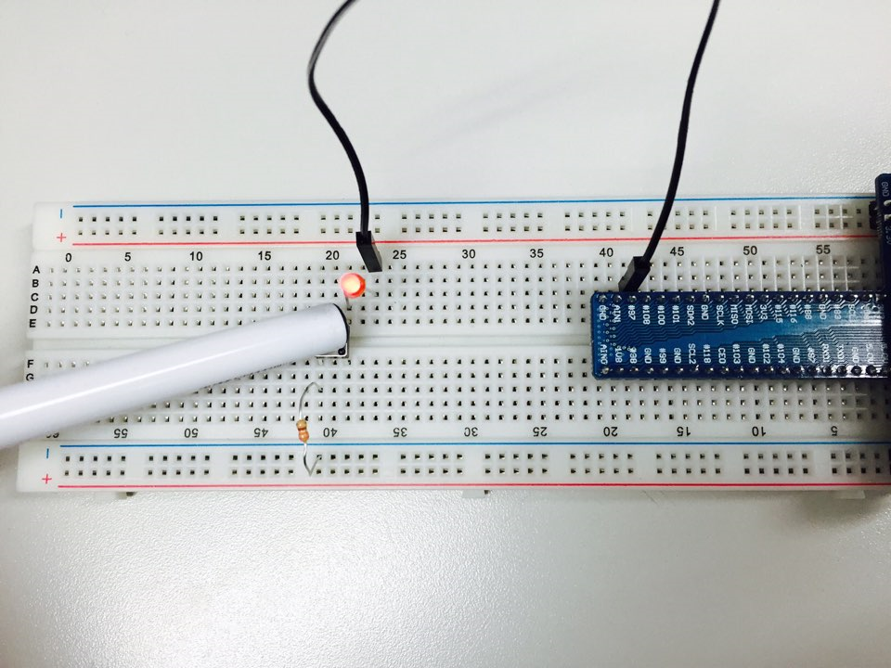
실행 결과
switch off
switch on

